Slide 1
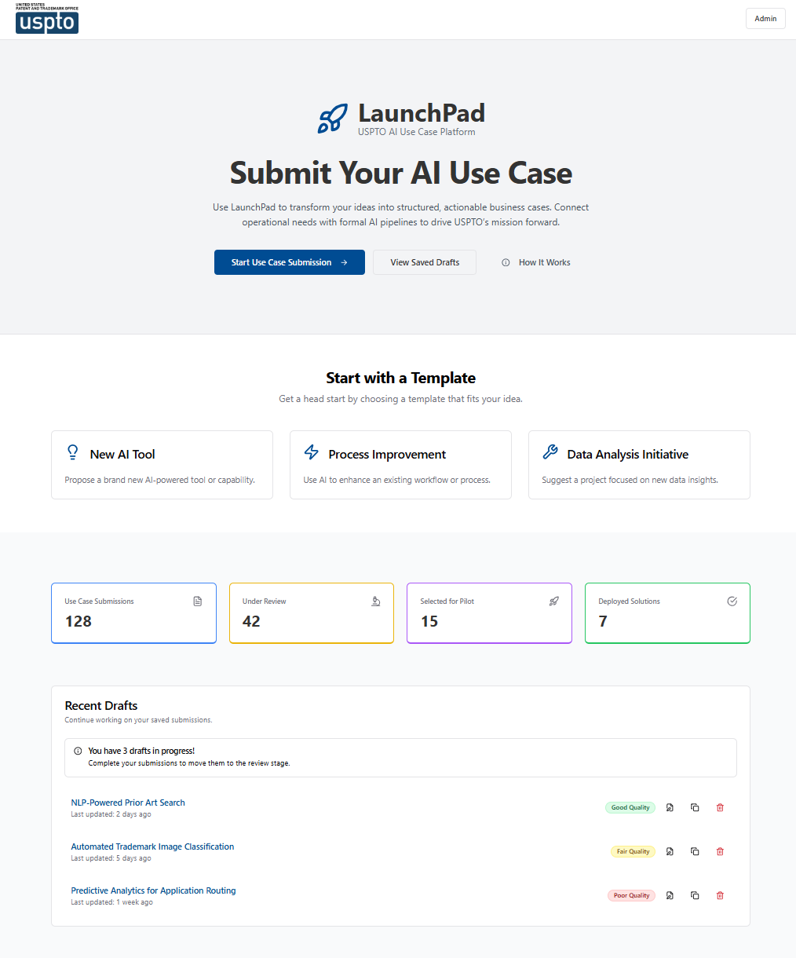
Launchpad for USPTO
The single-source for AI ideation and use case management at USPTO.
LaunchPad provides USPTO leadership with a single, flexible platform to capture raw AI ideas from across the agency and refine them into decision-ready use cases. Users are guided through an AI-assisted workflow: they first identify business problems and then refine their ideas with an AI Copilot before submission. Once submitted, Launchpad provides USPTO leadership with AI use cases that are ready for executive review.
Key Capabilities:
Guided AI-assisted workflow that transforms rough AI ideas into refined use cases that capture audience, business problem, value, and alignment to strategic objectives
AI Copilot challenges and refines each idea in real-time, identifying gaps before leadership ever sees it.
Configurable templates and smart fields (dropdowns, multi‑select chips, model card inputs) to meet DoC/OMB and USPTO governance requirements.
Routing capabilities to support review by E&I, CAIO, and OGL as needed.
Draft‑save and revision workflows for collaboration and iterative improvement before final submission.
Dashboard with live tracking: submitted, under review, approved, or deployed.
Exports to Rally (GovCloud) as Epics/Features and branded PDF business cases for executive review.
© 2026 Packaged Agile, LLC. Proprietary and Confidential.

Slide 2
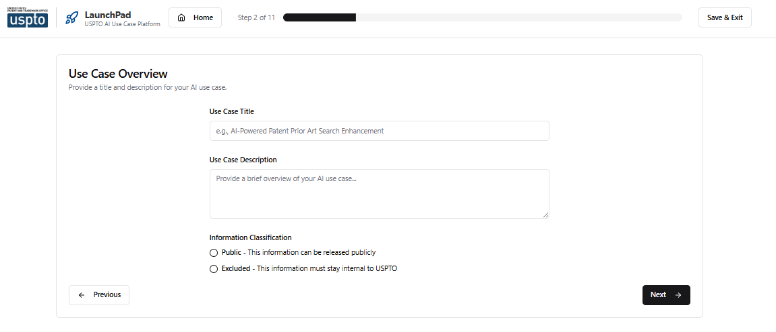
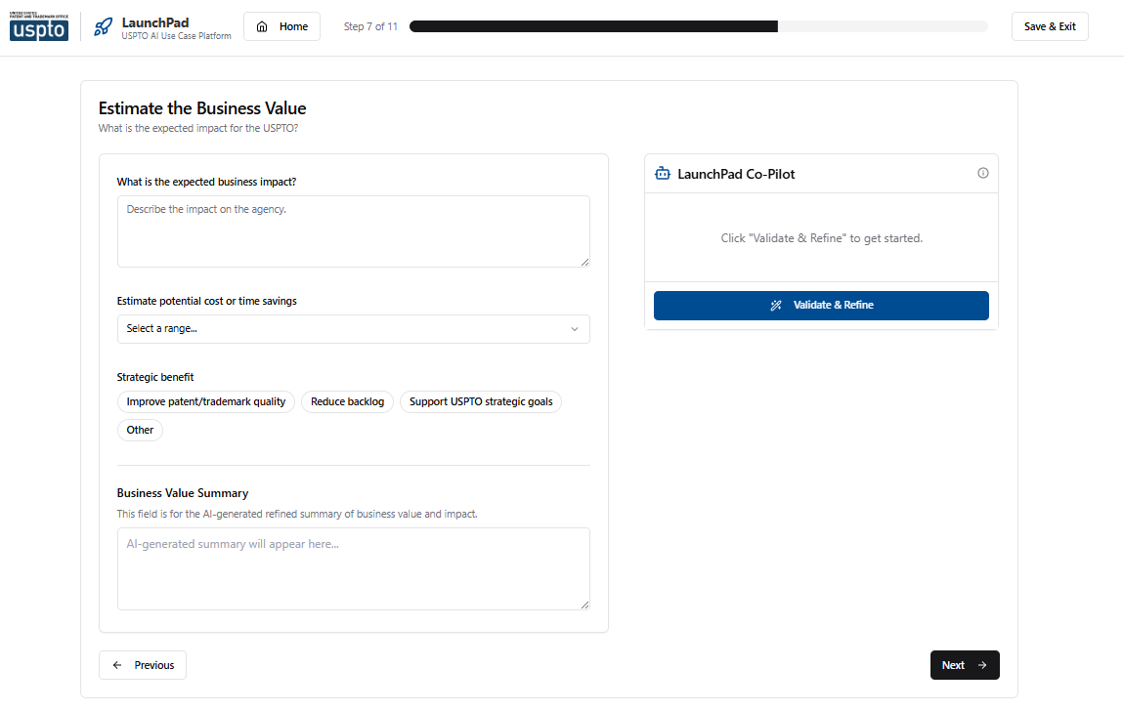
Guided Submission Workflow
11-step process vets raw ideas into decision-ready use cases with no training required
From Rough Idea to Business Case
LaunchPad walks every submitter through a structured, plain-language workflow that pressure tests their AI idea. Each step forces clarity on a specific dimension: audience, problem, solution, value, alignment, feasibility, and success metrics.
1–2
Submitter Info & Overview
Step 2: Use Case Overview
3–4
Target Users & Problem
5–7
Solution, User & Business Value
8
Strategic Alignment to OKRs
9–10
Feasibility & Success Metrics
11–12
Review, Submit & Confirm
© 2026 Packaged Agile, LLC. Proprietary and Confidential.
Step 7: Estimate Business Value with AI Co-Pilot

Slide 3



AI Co-Pilot: Validate & Refine
AI-powered vetting turns rough ideas into qualified, decision-ready use cases
How It Works
Architecture
At each step, the Co-Pilot challenges the submitter’s thinking, flagging gaps, questioning assumptions, and strengthening weak areas. One click generates a refined, submission-ready summary that’s already been pressure tested.
Next.js 14 + TypeScript
App Router, React Context
Tailwind CSS + shadcn/ui
USPTO Domain Expertise
USPTO-branded components
Vets ideas against federal constraints, FedRAMP, 508, and USPTO-specific realities
AI Integration Layer
Structured Output
Structured, validated responses from approved LLM
Schema-validated responses ensure consistent, well-formatted summaries every time
LLM Engine
Model agnostic. Adaptable to an approved endpoint
Dual-Field Architecture
Raw inputs preserved alongside AI-polished summaries
Flexible Deployment
Containerized for on-prem, Cloud.gov, or GovCloud
© 2026 Packaged Agile, LLC. Proprietary and Confidential.

Slide 4
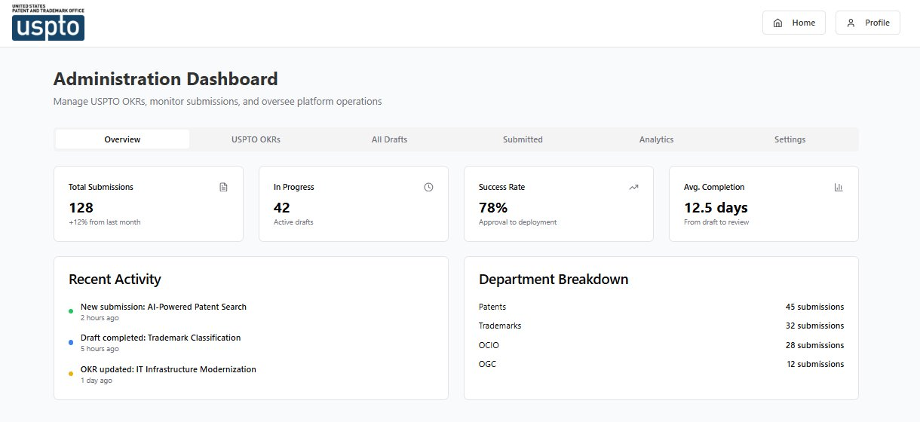
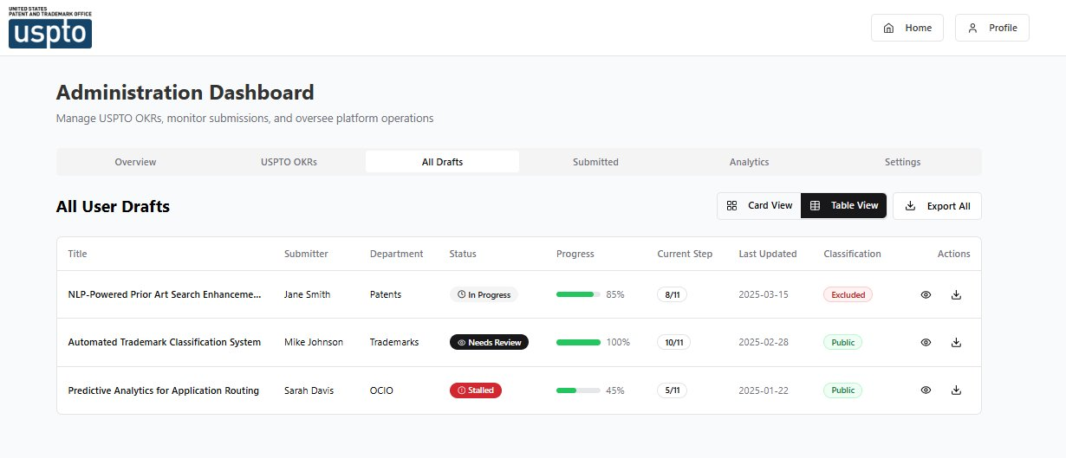
Administration Dashboard
Real-time visibility into the idea pipeline, from draft through approval
128
78%
12.5d
4
Total Submissions
Success Rate
Avg. Completion
Departments
+12% from last month
Approval to deployment
Draft to review
Patents, TM, OCIO, OGC
Overview: KPIs, Activity & Department Breakdown
All Drafts: Progress Tracking & Status Management
© 2026 Packaged Agile, LLC. Proprietary and Confidential.

Slide 5
Implementation Roadmap
Code-complete today: 8–12 weeks from kickoff to production
LaunchPad's codebase is built and functional. The path to production is adapting it to USPTO's on-prem infrastructure, identity systems, and AI access requirements.
Phase 1
Phase 2
Phase 3
Foundation
AI & Integration
Harden
Weeks 1–4
Weeks 5–8
Weeks 9–12
Containerize application (Docker)
Deploy to USPTO hosting environment
Integrate SSO / identity provider
Stand up database & migrate persistence
▸
Configure approved AI gateway endpoint
Adapt prompts for production LLM
Build Rally (GovCloud) export
Review routing, notifications, & 508
▸
Security scanning & pen testing
UAT with pilot group
ATO documentation support
Production cutover & admin training
Decision Points
Key Assumptions
Hosting: On-prem, Cloud.gov, or GovCloud?
AI access: FedRAMP'd Anthropic, Azure OpenAI, or internal gateway?
ATO: Standalone, or inherit existing boundary?
Dedicated 2–3-person team with environment access from day one
USPTO technical POC empowered to unblock decisions
Hosting & AI endpoint available or provisionable within Phase 1
Lightweight ATO path (pilot authority or inherited boundary)
© 2026 Packaged Agile, LLC. Proprietary and Confidential.

